Slide 1
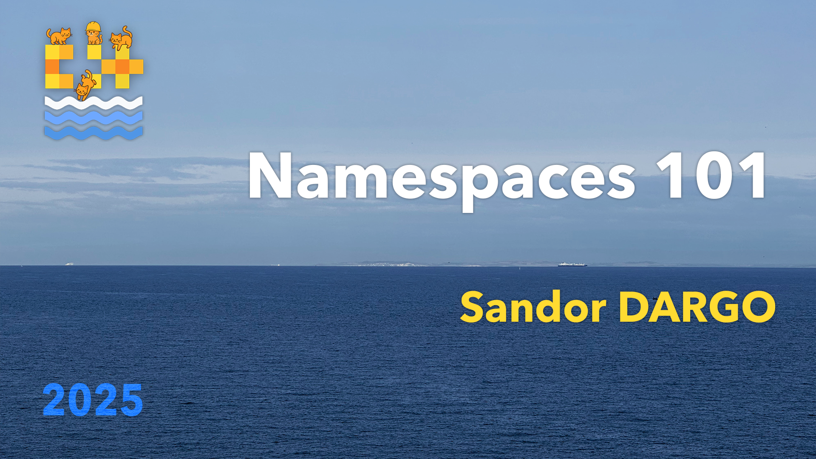


C++ Fundamentals: Namespaces 101
Sandor Dargo
C++ On Sea 23th June 2025, Folkestone (UK)
T W I T T E R @SandorDargo W E B sandordargo.com
Notes:
Main points are:
What is software quality & clean code
Their relationship
What can we do about them

Slide 2

Who Am I?
Sándor DARGÓ
Senior Engineer at Spotify
Enthusiastic blogger: sandordargo.com
Curious oenophile
Fortunate father of two
Notes:
‹#›

Slide 3
Why I'm Talking About Namespaces Today
Namespaces are a great tool for a cleaner code organization
Many developers miss out on their benefits; I used to!
I'll share practical tips I wish I'd known earlier on

Slide 4
Agenda
Introduction to Namespaces
Evolution of Namespaces
Namespace Mechanics and Scope Rules
Best Practices for using namespaces

Slide 5
Introduction to Namespaces
Introduction to Namespaces
Namespace Evolution
Namespace Mechanics and Scope Rules
Best Practices

Slide 6
What are namespaces?
They define new scopes
They are declared with the namespace keyword and a name
They can be nested or extended
You can access a namespace with the “scope resolution operator” (::)

Slide 7
Use namespaces for Better Code Organization
Organizes code in logical units, almost like code folders
Improves modularity and readability by creating logical units
Reduces the risk of redefinition errors and naming conflicts
Projects scale better, become more manageable
Essential for large/external code, avoids clashes

Slide 8
Real-World Problems Namespaces Solve
Avoids name collisions between different libraries
Keeps large projects' APIs manageable
Creates clear boundaries for modules

Slide 9
Namespace Evolution
Introduction to Namespaces
Namespace Evolution
Namespace Mechanics and Scope Rules
Best Practices

Slide 10
C++98: The Introduction of Namespaces
Key features from the start:
Name collision prevention
Logical code grouping
Scope control
The std namespace
The using directive and declaration
// https://godbolt.org/z/61rv7nqMe #include <iostream> namespace lib { int value = 42; void printValue() { std::cout << "value: " << value << ‘\n’; } } // namespace lib int main() { lib::printValue(); using namespace lib; // using directive std::cout << "value: " << value << ‘\n’; using std::cout; // using declaration cout << "Hello!" << ‘\n’; return 0; }
Notes:
The committee voted to accept namespaces into the standard in 1993. Most compilers supported it fairly shortly after that, so for around 5 years before the standard was approved.

Slide 11
C++11: inline Namespaces
Act like the enclosing scope
Treated as if they’re in the parent scope
// https://godbolt.org/z/MKWebf333 namespace my_library { namespace v1 { void printMessage() { /* … */ } } // namespace v1 inline namespace v2 { void printMessage() { /* … */ } } // namespace v2 } // namespace my_library int main() { my_library::v1::printMessage(); // v1 my_library::v2::printMessage(); // v2 my_library::printMessage(); // also v2! }

Slide 12
C++11: inline Namespaces
Act like the enclosing scope
Treated as if they’re in the parent scope
Makes versioning easier
// https://godbolt.org/z/MKWebf333 namespace my_library { namespace v1 { void printMessage() { /* … */ } } // namespace v1 inline namespace v2 { void printMessage() { /* … */ } } // namespace v2 } // namespace my_library int main() { my_library::v1::printMessage(); // v1 my_library::v2::printMessage(); // v2 my_library::printMessage(); // also v2! }

Slide 13
C++11: inline Namespaces
Act like the enclosing scope
Treated as if they’re in the parent scope
Makes versioning easier
The inline version can be directly used
// https://godbolt.org/z/MKWebf333 namespace my_library { namespace v1 { void printMessage() { /* … */ } } // namespace v1 inline namespace v2 { void printMessage() { /* … */ } } // namespace v2 } // namespace my_library int main() { my_library::v1::printMessage(); // v1 my_library::v2::printMessage(); // v2 my_library::printMessage(); // also v2! }

Slide 14
C++11: inline Namespaces
Act like the enclosing scope
Treated as if they’re in the parent scope
Makes versioning easier
The inline version can be directly used
Ideal for the latest version
// https://godbolt.org/z/MKWebf333 namespace my_library { namespace v1 { void printMessage() { /* … */ } } // namespace v1 inline namespace v2 { void printMessage() { /* … */ } } // namespace v2 } // namespace my_library int main() { my_library::v1::printMessage(); // v1 my_library::v2::printMessage(); // v2 my_library::printMessage(); // also v2! }

Slide 15
C++17: Nested Namespace Openings
Becomes easier to open nested namespaces
Before:
namespace outer { namespace inner { class Widget; } // namespace inner } // namespace outer
After:
namespace outer::inner { class Widget; } // namespace outer::inner

Slide 16
C++20: Nested Inline Namespaces
Becomes easier to open nested inline namespaces
Before:
namespace outer::middle { inline namespace inner { class Widget; } // namespace inner } // namespace outer::middle
After:
namespace outer::middle::inline inner { class Widget; } // namespace outer::middle…

Slide 17
Namespace Mechanics and Scope Rules
Introduction to Namespaces
Namespace Evolution
Namespace Mechanics and Scope Rules
Best Practices

Slide 18
Name lookup rules

Slide 19
What is qualified name look up?
When you see a::b::x, that's a qualified name
Lookup starts with what's left of :: (a::b in this case).
The search is confined to the specified scope
It doesn't jump to outer scopes automatically
using directives in the named scope are considered

Slide 20
Qualified name lookup – Example 1)
We ask for a::b::x
First, lookup happens in a::b.
x is found there!
using namespace c; also introduces x, but it has lesser priority
// https://godbolt.org/z/EnT67enxv #include <print> namespace c { int x = 3; } // namespace c
namespace a::b {
using namespace c;
int x = 2;
} // namespace a::b
int main() {
std::println("{}", a::b::x);
}

Slide 21
Qualified name lookup – Example 2)
We ask for a::b::x
First, lookup happens in a::b.
x is now commented out!
x is still found thanks to using namespace c;
// https://godbolt.org/z/8oe1e3zYE #include <print> namespace c { int x = 3; } // namespace c
namespace a::b {
using namespace c;
// int x = 2;
} // namespace a::b
int main() { std::println("{}", a::b::x);
}

Slide 22
Qualified name lookup – Example 3)
We ask for a::b::w
First, look happens in a::b. It has no w !
Qualified lookup doesn't check in a
Hence the compiler error
// https://godbolt.org/z/KW6asrha4 #include <print>
namespace a {
int w = 66;
namespace b {}
} // namespace a
int main() { // ERROR!
std::println("{}", a::b::w);
}

Slide 23
Unqualified name lookup
For symbols not appearing on the right hand side of ::
int x = 2;
int func() {
int x = 3; // UNL finds local x = 3
int y = x; // QNL finds global x = 2
int z = ::x;
return y * z; // 3 * 2
}

Slide 24
Unqualified name lookup
For symbols not appearing on the right hand side of ::
Lookup goes outward to find a declaration:

Slide 25
Unqualified name lookup
For symbols not appearing on the right hand side of ::
Lookup goes outward to find a declaration: Local scope(s): innermost to extern
int func() {
int x = 3;
int y;
{
// No x here; lookup continues // to the enclosing function scope
y = x;
}
return y;
}

Slide 26
Unqualified name lookup
For symbols not appearing on the right hand side of ::
Lookup goes outward to find a declaration: Local scope(s): innermost to extern Class/struct scope
struct Widget {
int func() {
// No local x; lookup finds member x
int y = x;
return y;
}
int x = 3;
};

Slide 27
Unqualified name lookup
For symbols not appearing on the right hand side of ::
Lookup goes outward to find a declaration: Local scope(s): innermost to extern Class/struct scope Namespaces: innermost to extern
// https://godbolt.org/z/ccq4dnoWj #include <print>
namespace a {
int n = 1;
namespace b {
int f() {
return n; // Finds a::n (outer namespace)
}
} // namespace b
} // namespace a
int main() {
std::println("{}", a::b::f()); // 1
}

Slide 28
Unqualified name lookup
For symbols not appearing on the right hand side of ::
Lookup goes outward to find a declaration: Local scope(s): innermost to extern Class/struct scope Namespaces: innermost to extern Global scope
// https://godbolt.org/z/hTrM3ox8c #include <print>
int n = 1;
namespace a {
namespace b {
int f() {
return n; // Finds n in the global scope
}
} // namespace b
} // namespace a
int main() {
std::println("{}", a::b::f()); // 1
}

Slide 29
Unqualified name lookup
For symbols not appearing on the right hand side of ::
Lookup goes outward to find a declaration: Local scope(s): innermost to extern Class/struct scope Namespaces: innermost to extern With the same priority: Global scope Namespaces introduced via using directives
// https://godbolt.org/z/PaGTTq4Ks #include <print> int x = 2;
namespace c {
int x = 8, z = 7;
} // namespace c
namespace a {
namespace b {
int g() {
using namespace c;
return z;
}
int h() {
// using namespace c;
// If uncommented, ambiguity between ::x and c::x
return x;
}
} // namespace b
} // namespace a
int main() {
std::println("{}", a::b::g()); // 7
std::println("{}", a::b::h()); // 2
}

Slide 30
Unqualified name lookup
For symbols not appearing on the right hand side of ::
Lookup goes outward to find a declaration: Local scope(s): innermost to extern Class/struct scope Namespaces: innermost to extern With the same priority: Global scope Namespaces introduced via using directives Using declarations have local scope prio!
// https://godbolt.org/z/Kx8qdWa7T
#include <print>
namespace c {
int z = 7;
} // namespace c
namespace d {
int z = 42;
} // namespace d
namespace a::b {
int g() {
using d::z;
// if uncommented, d::z and local z condflicts
// int z = 66;
using namespace c;
return z;
}
} // namespace a::b
int main() {
std::println("{}", a::b::g()); // 7
}

Slide 31
QNL and UNL often go hand in hand
b::x triggers both lookups
First, unqualified for b in b::x is
Then, qualified for x in b::x
// https://godbolt.org/z/P4c1roYEq int x = 1;
namespace b {
int x = 2;
} //namespace b
namespace a::b {
int x = 3;
namespace c {
int foo() {
// return ::b::x; // returns 2
return b::x; // returns 3
}
} // namespace c
} // namespace a::b

Slide 32
Argument-Dependent Lookup
Extends unqualified name lookup
Only for functions calls
Makes function calls "just work"
Brings into scope the function arguments’ namespaces
Especially helpful for operator overloading or generic code
// https://godbolt.org/z/saYvGKehj namespace math {
struct Vec {}; struct Bar {
Bar(Vec v): _v(v){}
Vec _v;
};
void normalize(Vec) {}
bool operator==(Vec, Vec) { return true; }
} // namespace math
void foo() {
math::Vec a, b;
normalize(a); // OK via ADL
if (a == b) {} // OK via ADL
// ERROR: ADL does not apply to class names // Bar c(a);
}

Slide 33
Bringing namespaces into scope

Slide 34
Using directives: using namespace ns;
Brings all the symbols of a namespace into the current scope
It might decrease readability as who knows what comes from where
A double edged sword, as it pollutes the namespace
// lib.h namespace lib { void print() { std::cout << "lib::print()" << "\n"; } } // namespace lib // main.cpp #include <lib/lib.h> int main() { // Bring all symbols from lib into scope using namespace lib; print(); // Where does this come from? return 0; }

Slide 35
What is namespace pollution? 🤔

Slide 36
It’s when you have too many identifiers in a namespace, causing conflicts and confusion

Slide 37
Namespace pollution is a problem - Example 1)
// https://godbolt.org/z/q13fh17Eb // helper.hpp #pragma once #include <iostream> // BAD PRACTICE: introduces `cout` // (and others) into a header! using namespace std; namespace foo { void display(const std::string& msg) { cout << "Message: " << msg << '\n'; } } // namespace foo
// main.cpp #include "helper.hpp" #include <iostream> void cout(const std::string& s) { // Intentional user-defined function // named `cout` std::printf("Custom cout: %s\n", s.c_str()); } int main() { foo::display("Hello"); // Intended to use user-defined // cout, but error! cout("Direct call"); return 0; }

Slide 38
Namespace pollution is a problem - Example 2)
// https://godbolt.org/z/64E64xdG9 // ns1.hpp #pragma once namespace ns1 { double calculate(double value) { return 4.2 * value; } } // namespace ns1
// main.cpp #include "ns1.hpp" #include <iostream> int main() { using namespace ns1; std::cout << calculate(2) << ‘\n’; return 0; }

Slide 39
Namespace pollution is a problem - Example 2)
// https://godbolt.org/z/WErPza134 // ns1.hpp #pragma once namespace ns1 { double calculate(double value) { return 4.2 * value; } } // namespace ns1
// ns2.hpp #pragma once namespace ns2 { int calculate(int value) { return 42 * value; } } // namespace ns2
// main.cpp #include "ns1.hpp" #include "ns2.hpp" #include <iostream> int main() { using namespace ns1; using namespace ns2; std::cout << calculate(2) << ‘\n’; return 0; }

Slide 40
Namespace pollution is a problem
With name clashing you can get
Compilation errors
Worse, unexpected behaviour
Maintenance is difficult due to potentially even more naming conflicts
Readability suffers as you don’t see what comes from where

Slide 41
Yet, use using directives for literal namespaces!
Using directives pollute
Still useful for literals!
Cannot be used otherwise
They are carefully designed
They enhance readability
using namespace std::chrono_literals;
auto duration = 5s; // ✅ auto duration2 = std::chrono::seconds(5);
// This doesn’t work:
// auto duration = std::chrono_literals::5s; // ❌

Slide 42
Using-declarations: using ns::symbol;
Instead of bringing in all symbols, it brings only the specified ones
Classes
Functions
Variables
Enums
Even enumerators since C++20
Better than the directive, but it can still pollute
// lib.h namespace lib { void print() { std::cout << "lib::print()" << "\n"; } } // namespace lib // main.cpp #include <lib/lib.h> int main() { // Bring only one symbols into scope using lib::print; print(); // Its origin is clear! return 0; }

Slide 43
Using-declarations > using-directives
If a symbol is introduced by both Using-declaration has priority
https://godbolt.org/z/5oPv9o7vq namespace a { int x = 1; } // namespace a namespace b { int x = 2; } // namespace a int main() { using namespace a; using b::x; return x; }

Slide 44
Namespaces can be aliased
Shortens long namespace names
Might improve readability
Doesn’t pollute directly
#include <print>
namespace a::b::c {
int x = 42;
}
int main() {
std::println("{}", a::b::c::x);
namespace abc = a::b::c; // still a qualified name:
std::println("{}", abc::x);
}

Slide 45
Namespaces can be aliased
Shortens long namespace names
Might improve readability
Doesn’t pollute directly
Yet, using them in headers are risks shadowing or redefinition
// lib.hpp #pragma once
namespace mylib::utils {
void do_something();
}
// Alias defined in header
namespace mu = mylib::utils; // main.cpp #include "lib.hpp"
// This conflicts with the alias!
namespace mu {
void other_thing();
}
int main() { // Which 'mu' is this?
mu::do_something();
}

Slide 46
Namespaces can be aliased
Shortens long namespace names
Might improve readability
Doesn’t pollute directly
Yet, using them in headers are risks shadowing or redefinition
Best to use it in .cpp files

Slide 47
Impacts on readability and maintainability
⚠️ Using directives and declarations pollute namespaces
⚠️ Using directives might decrease readability
✅ Literals are still good!
✅ Using declarations are a better option
✅ Aliases can improve readability

Slide 48
Anonymous Namespaces

Slide 49
Anonymous namespaces have no name
Limits the scope to internal linkage
Makes symbols private to a translation unit
Helps avoiding clashes
Preferred to static functions
The right place for implementation details
namespace { std::string millisecondsToString( std::chrono::milliseconds ms) { return std::to_string(ms.count()); } } // namespace namespace rns { void Widget::update() { print(millisecondsToString(time)) } } // namespace rns

Slide 50
Best Practices for using namespaces
Introduction to Namespaces
Namespace Evolution
Namespace Mechanics and Scope Rules
Best Practices

Slide 51
What is covered in coding standards and style guides?

Slide 52
Core C++ Guidelines
C.5: Place helper functions in the same namespace as the class they support
C.168: Define overloaded operators in the namespace of their operands
T.47: Avoid highly visible unconstrained templates with common names?
SF.6: Use using namespace directives for transition, for foundation libraries (such as std), or within a local scope (only)
SF.7: Don’t write using namespace at global scope in a header file
SF.20: Use namespaces to express logical structure
SF.21: Don’t use an unnamed (anonymous) namespace in a header
SF.22: Use an unnamed (anonymous) namespace for all internal/non-exported entities
SL.3: Do not add non-standard entities to namespace std

Slide 53
C.5: Place helper functions in the same namespace as the class they support
They are seen as part of the class interface
Makes the relationship obvious
Allows benefiting from ADL
namespace chrono { // here we keep time-related services class Time { /* ... */ }; class Date { /* ... */ };
// helper functions: bool operator==(Date, Date); Date next_weekday(Date); // ... } // namespace chrono

Slide 54
C.168: Define overloaded operators in the namespace of their operands
Allows benefiting from ADL
Increases readability
No inconsistent definitions in different namespaces
namespace N { struct S { };
// OK: in the same namespace as S // and even next to S S operator+(S, S); } // namespace N N::S s; // finds N::operator+() by ADL S r = s + s;

Slide 55
T.47: Avoid highly visible unconstrained templates with common names
// https://godbolt.org/z/obax699Ev namespace bad { struct S { int m; }; template<typename T1, typename T2> bool operator==(T1, T2) { cout << "bad\n"; return true; } } // namespace bad namespace t0 { bool operator==(int, bad::S) { cout << "t0\n"; return true; } // compare to int void test() { bad::S bad{ 1 }; vector<int> v(10); bool b = 1 == bad; // t0 bool b2 = v.size() == bad; // bad } } // namespace t0
Such template arguments match anything
Annoying and dangerous with ADL
“The committee cannot agree to exclude unconstrained templates from ADL”

Slide 56
SF.6: Use using namespace directives for transition, for foundation libraries, or within a local scope
using namespace can lead to name clashes
Even std can clash with the standard library
But sometimes consistent qualification is verbose and distracting
// https://godbolt.org/z/nT16xcnW1 #include <cmath> using namespace std; int g(int x) { int sqrt = 7; // … return sqrt(x); // error }

Slide 57
SF.7: Don’t write using namespace at global scope in a header file
Pollutes global namespace
Might introduce order dependency
Exception is using namespace std::literals
// bad.h #include <iostream> using namespace std; // bad // user.cpp #include "bad.h" // some function that // happens to be named copy bool copy(/*... some parameters ...*/); int main() { // now overloads local ::copy // and std::copy, could be ambiguous copy(/*...*/); }

Slide 58
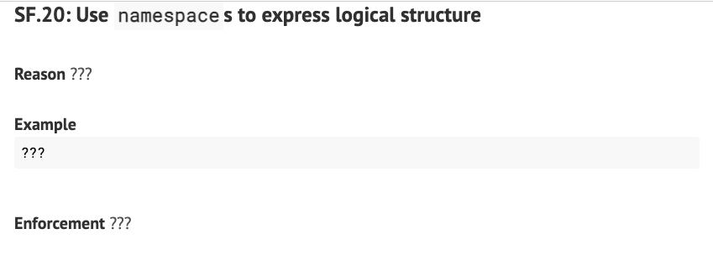
SF.20: Use namespaces to express logical structure
The Guidelines have nothing to say 🤓
Maybe it’s considered too obvious
Namespaces are not only for avoiding name clashes
But to represent logical and/or domain structure
And improve readability and modularity
Some practical advice will come later

Slide 59
SF.21: Don’t use unnamed namespaces in headers
Anonymous namespaces give internal linkage
Each cpp file including such a header gets its own version of the “contents”
Code bloat
ODR violations
Possible bugs with static data
Instead
Use normal namespaces
Use inlining to avoid ODR violation
Use detail namespaces
// file foo.h: namespace { // bad const double x = 1.234; const double y = 2.345; double foo(double y) { return y + x; } } // namespace namespace foo { //good const double x = 1.234; namespace detail { const double y = 2.345; } // detail inline double foo(double y){ return y + x; } } // namespace foo

Slide 60
SF.22: Use an unnamed (anonymous) namespace for all internal/non-exported entities
Nothing external can use symbols in an unnamed namespace
Unless a definition is exported, put it in an anonymous namespace
// Instead of
static int f(); int g(); static bool h(); int k();
// Prefer using namespace { int f(); bool h(); } // namespace int g(); int k();

Slide 61
SL.3: Do not add entities to namespace std
Adding to std might change the meaning of otherwise standards conforming code.
Additions to std might clash with future versions of the standard.
It is even undefined behavior to add declarations or definitions to std
Except for some template specializations!
namespace std { // UB: not allowed void my_utility() { /* ... */ } // UB! bool operator==(const vector<int>&, const vector<int>&);
} // namespace std

Slide 62
SL.3: Do not add entities to namespace std (cont)
Except for some template specializations
If the declaration depends on at least one user-defined type
And the specialization satisfies all requirements for the original template
template<> struct std::hash<MyType> { std::size_t operator()( const MyType& t) const { return t.hash(); } };

Slide 63
Google C++ Style Guide
✅ Use namespaces generously
❌ using directives are forbidden, use namespace aliases instead
✅ using declarations are fine
❌ inline namespaces are forbidden (allowed only for versioning)
❌ No anonymous namespaces in header files

Slide 64
Google C++ Style Guide
Namespace names should use snake_case Top-level namespaces must be globally unique and recognizable
Nested namespaces should avoid well-known top-level namespaces
The contents of namespaces are not indented
Use closing comments, for anonymous namespaces leave the name empty

Slide 65
Google C++ Style Guide - Formatting
The contents of namespaces are not indented.
There is a closing comment
namespace foo {
// Wrong! // Indented, when it // should not be. void foo() { // … }
}
namespace foo { // Correct. // No extra indentation // within namespace. void foo() {
...
}
} // namespace foo

Slide 66
Personal and organizational experience
✅ using declarations are fine in .cpp files
❌Limit using directives to and even in .cpp files
❌Avoid namespace aliases, especially in header files
❌No more than 4 level nested namespaces (the top one is all the same)
⚠️Differentiate between impl, detail, potentially detail or api
⚠️Always fully qualify in macros
⚠️Opening up a foreign namespace is often a code smell (it can happen sometimes)

Slide 67
Limit using declarations to .cpp files
Using directives are forbidden in header files
Also better to be avoided in .cpp files as they worsen readability
Use using declarations as much as you need if they improve readability
Don’t use them in the header files to avoid namespace pollution

Slide 68
No more than 4 level nested namespaces
Deeply nested namespaces can lead to name clashes due to UNL
Though the risk can be eliminated if only leaf NSs are used for symbols
While intermediary NSs are used for code organization
Too deep NSs are also too verbose and hard to read
Usually we use 3 levels
There might be an extra level for bigger modules and details

Slide 69
Always fully qualify in macros!
First of all, don’t use macros! 😉
Macros are never part of namespaces
They are expanded before compilation
The preprocessor knows nothing about namespaces
Always fully qualify symbols in macros to avoid lookup issues
// https://godbolt.org/z/c5Ec8cdKK namespace foo { class Widget {}; #define WW(n) Widget n; } // namespace foo namespace bar { // error: 'Widget' was not declared // in this scope; did you mean // 'foo::Widget'? void use_macro() { WW(x); } } // namespace bar int main() { bar::use_macro(); }

Slide 70
Opening up a foreign namespace is often a code smell
Each usage is a sign of dependency
Some are essential…
Too many should probably warn you

Slide 71
Industry best practices are less permissive then Core Guidelines
Core guidelines protects mostly the global namespace
Most coding guidelines protect user defined namespaces as well

Slide 72
Time to conclude!

Slide 73
Key takeaways
Use namespaces to prevent name collisions and organize code
Avoid polluting the namespaces
Prefer fine-grained and nested namespaces over large monolithic ones
Keep naming consistent and meaningful

Slide 74
Some practical tips
✅ Do
Use namespaces to group related code
Use using declarations in .cpp files
Use namespace alias when helpful
Might use inline namespace for versions
❌ Don't
Use using namespace std; in headers
Over-nest deeply without reason
Assume readers know where symbols come from
Dump everything into namespace util

Slide 75
C++ Fundamentals: Namespaces 101
Sandor Dargo
C++ On Sea 23th June 2025, Folkestone (UK)
T W I T T E R @SandorDargo W E B sandordargo.com

